Slide 1
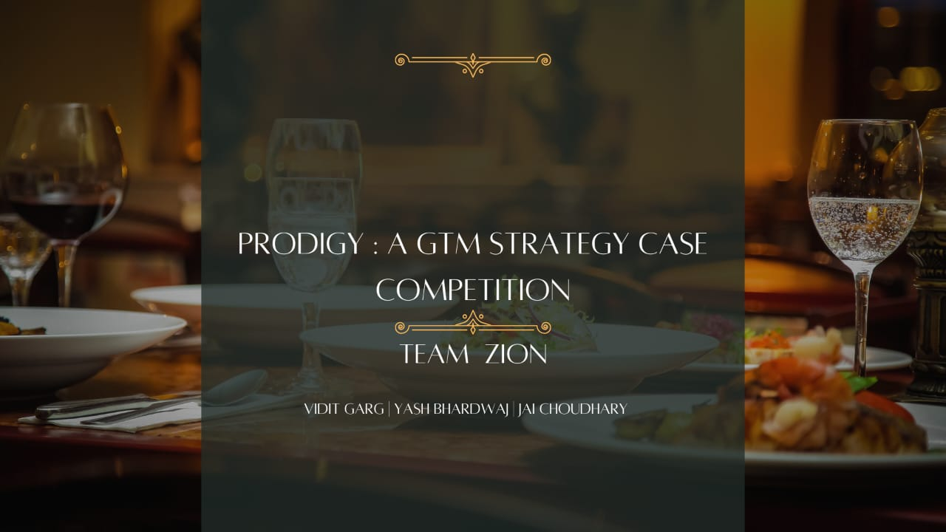
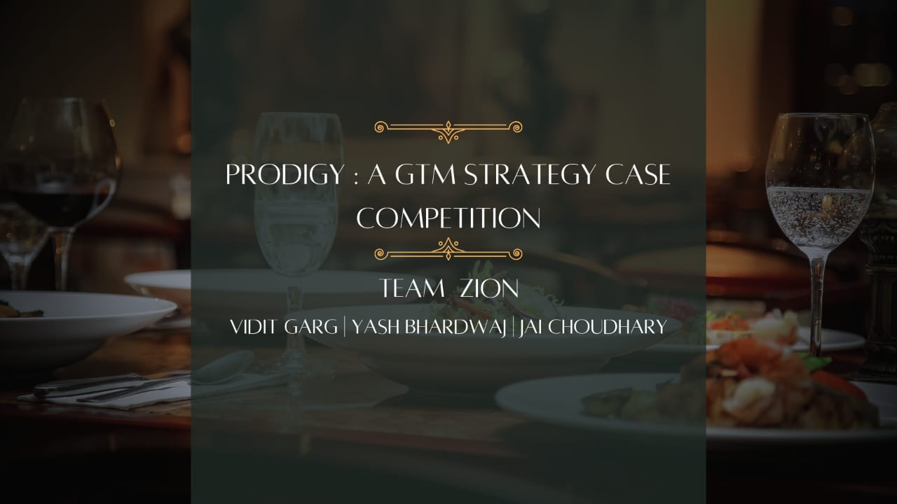
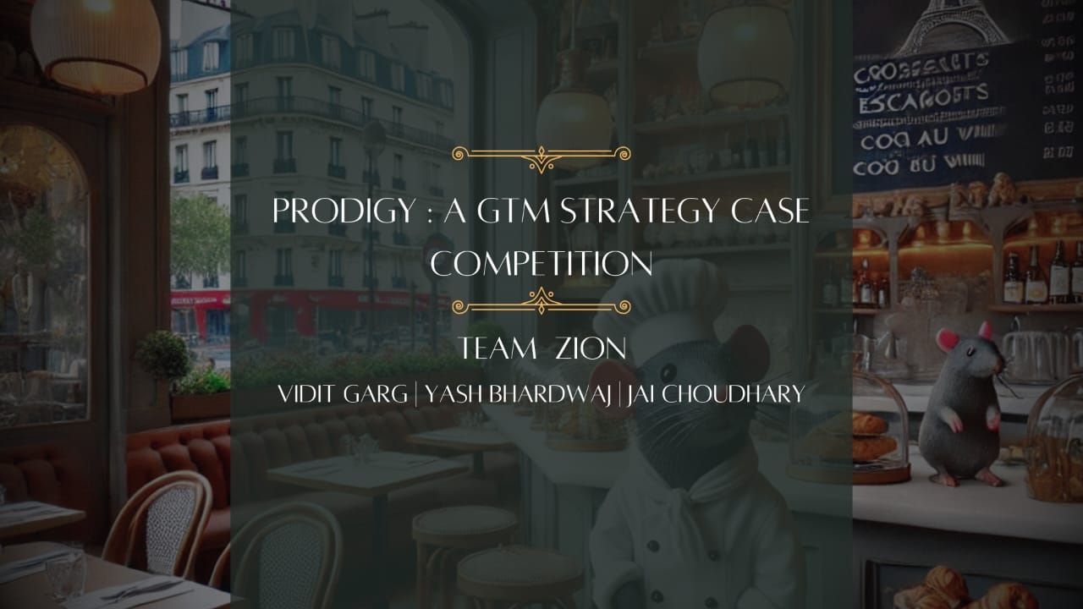

SHAHEED SUKHDEV COLLEGE OF BUSINESS STUDIES, UNIVERSITY OF DELHI

Slide 2










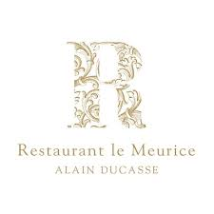
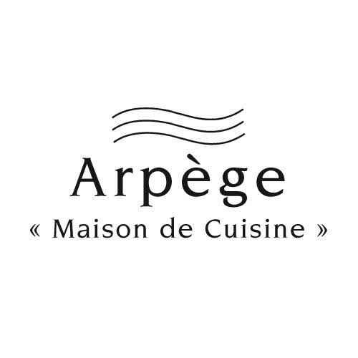


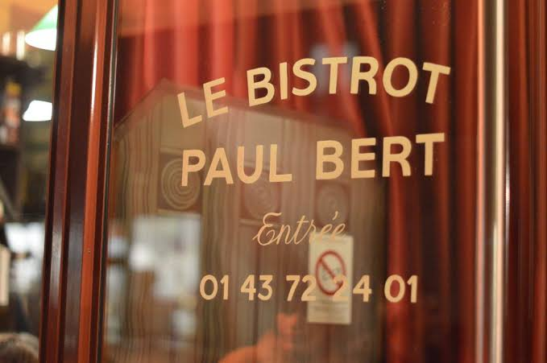




MARKET RESEARCH AND INSIGHTS
Looking into the Restaurant market of France and potential insights
VENTURING INTO THE RESTAURANT INDUSTRY
GROWTH DRIVERS
ANALYSING POTENTIAL PERSONAS
Paris's restaurant industry is renowned for its blend of traditional French cuisine and global influences, featuring nearly 200 Michelin-starred restaurants and a growing trend towards health-conscious dining and fusion cuisines..
France has become
The Hub Of Food Tourism
2.9 mn Millionaires
lives in France
$77.28 Bn
dollar industry
Julien martin, an Investment Banker
Maria Curie, a Luxury Travel Vlogger
Julien n Group,
Tourists
120
100
80
60
40
20
0
6.13% CAGR
90% of Parisians dine out monthly, driving demand for unique dining
Pain Points
Pain Points
Pain Points
Overcrowded fine dining, difficulty in maintaining professional standards
Difficulty finding luxury Experience, faces pressure balancing authentic food with exclusivity
Difficulty in finding cultural taste, exploring authenticity, prefers unique over mainstream experience
6.13% CAGR (2024-29)
$77.28 Bn
104.08 Bn
82% of Parisians prefer comfort and exclusivity over money
REVOLVING AROUND MILLIONAIRES
CONSUMER PREFERENCES
COMPETITOR’S MATRIX
Least Important
Most Important
HIGH PRICING
Number of dollar millionaire (in millions) in selected countries in 2000, 2023 and 2028
Our Main Focus
Consumer Preferences
Our
Canvas
Food quality
Employee’s Service
Menus
Order Accuracy
Discount Offers
Speed
6.6%
0.4%
INDIRECT COMPETITION
DIRECT COMPETITION
4.2%
2.3%
Willing to pay more when getting good Food Quality and Service
Share of Population in 2023
LOW PRICING
Market Research
Market Entry Strategy
Customer Value Proposition
Marketing & Promotion
Appendix
Size & Timeline
2
1

Slide 3










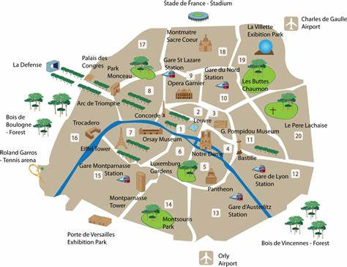


MARKET ENTRY STRATEGY
How can L’Élégance du Passé build a strong supply chain and reach the Parisian Audience
OWNER’S BACKGROUND
SUPPLY CHAIN AND LOGISTICS
Chef Remy(rat), is an extraordinary culinary prodigy with an unique journey that defies conventions. He has honed his skills through determination and an innate passion for gastronomy
LA RUCHE QUI DIT OUI
The Premier Supplier
X
Achievements of Chef Remy
Winner of Le Gourmet d'Or (2021): Recognized for his innovative reinterpretation of classic French dishes.
Master of French Cuisine (2022): Lauded for exceptional creativity and mastery of traditional techniques.
Culinary World Cup (2023): Earned international acclaim for his bold flavors and artistic presentations.
Sustainability Focus
High-Quality Ingredients
LA RUCHE QUI DIT OUI
L’ÉLÉGANCE DU PASSÉ
Strong Reputation
Flexibility in Supply
THE HISTORICAL TIMELINE RESTAURANT
Welcomes over 10mn visitors Annually
Famous for its Artistic and Cultural Heritage
RENAISSANCE (1500s)
BELLE EQUOPE (1900s)
MODERN PARIS (2000s)
Hearty stews, artisanal breads, and medieval-inspired beverages
Elegant French pastries, classic dishes like Ratatouille and Quiche Lorraine.
Innovative fusion dishes, plant-based options, and molecular gastronomy.
Theme: "La Quintessence" (The Essence of Fine Dining)
Aligned with the Idea of Rat Chef
Serves 200+ restaurants and Cafe`s
Elements For Execution
Ambience
Decor
Music: Soft, live classical performances such as piano or violin on select evenings. Lighting: Subtle, warm lighting to create an intimate and sophisticated atmosphere.
Inspired by 18th-century French salons, featuring vintage chandeliers, fine marble, and plush velvet seating.
Use of neutral tones with gold and silver accents to reflect timeless luxury.
Why Montmartre is the Ideal Location for us…
Market Research
Market Entry Strategy
Market Entry Strategy
Appendix
Customer Value Proposition
Appendix
Customer Value Proposition
Marketing & Promotion
Marketing & Promotion
Size & Timeline
Size & Timeline
2
2

Slide 4
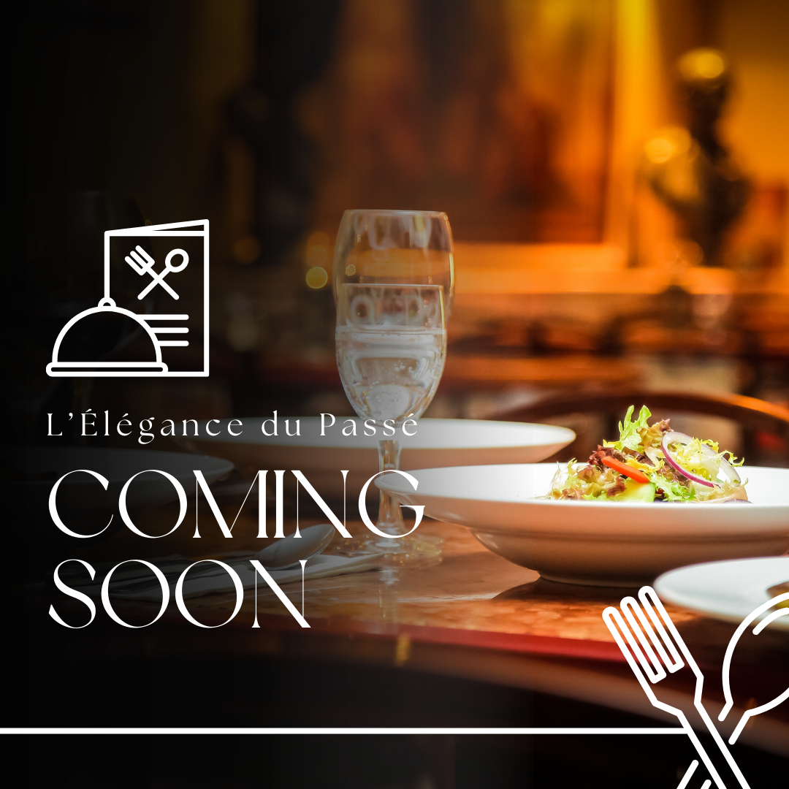
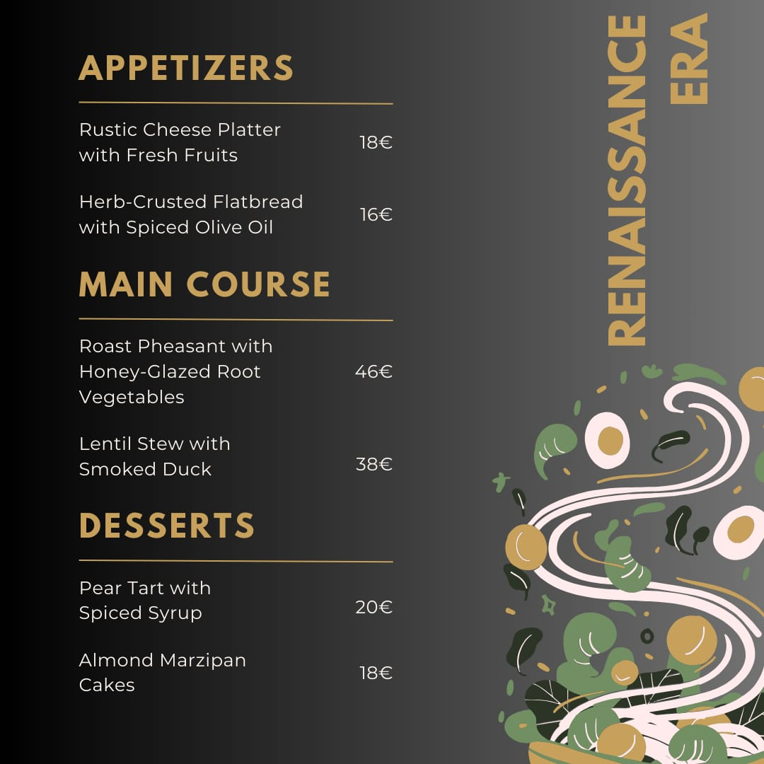
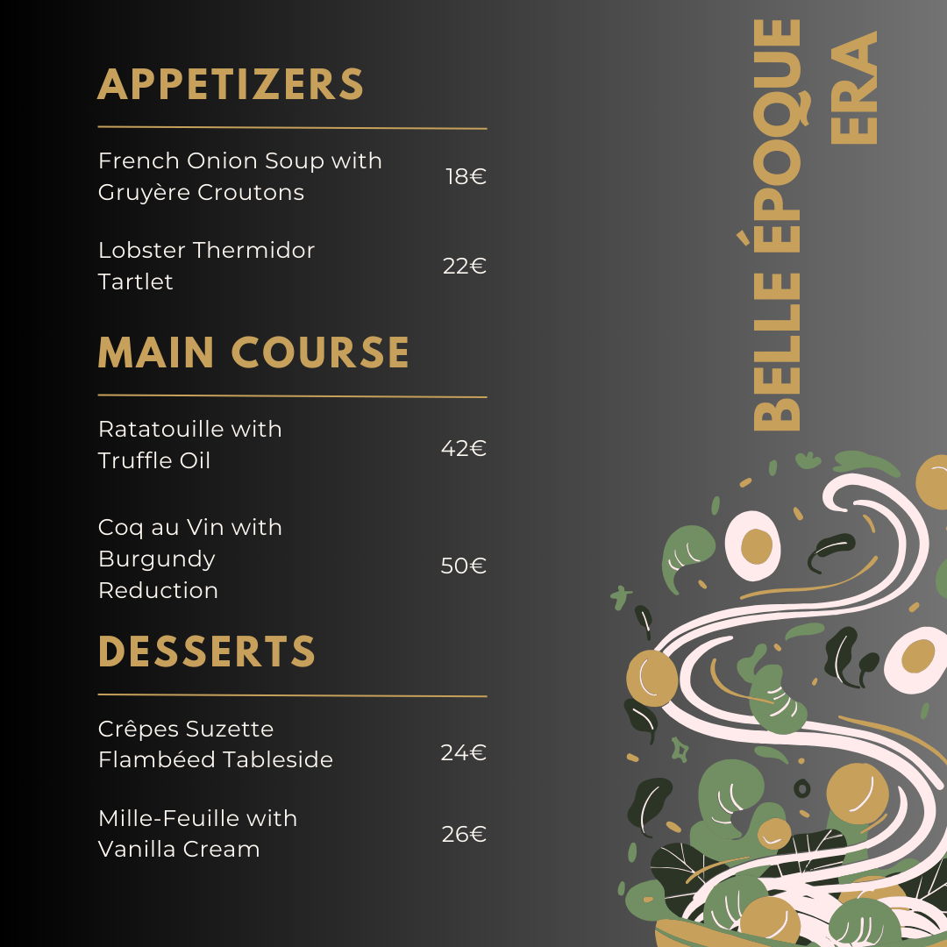
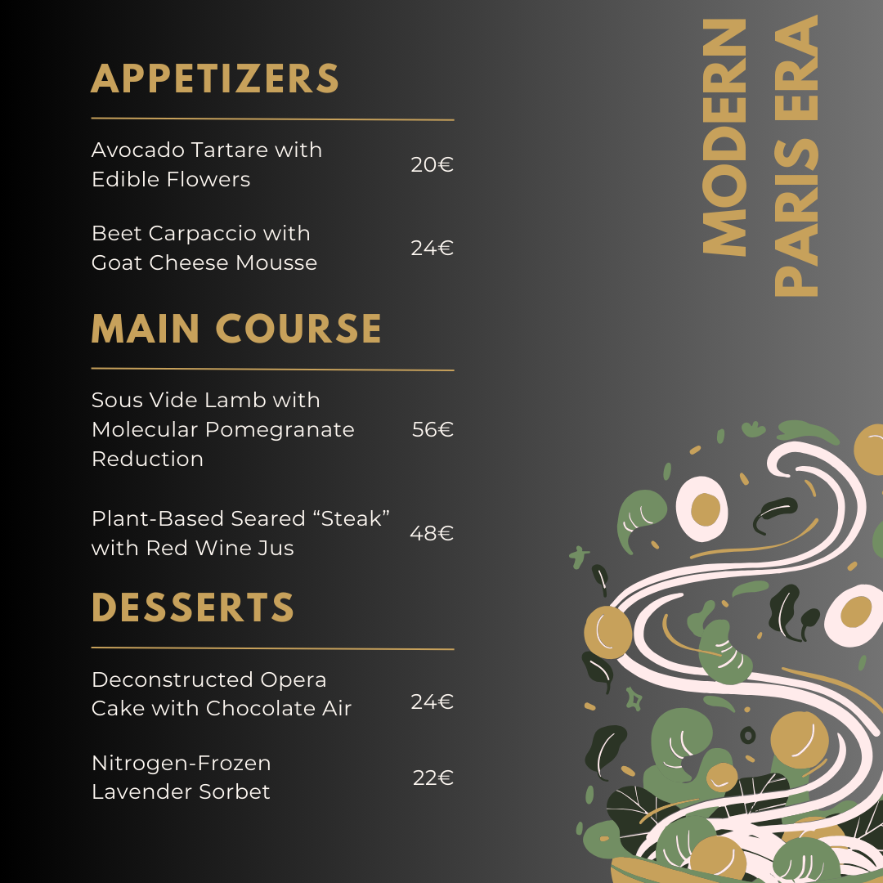












CUSTOMER VALUE PROPOSITION
Introductory Menu of L’Élégance du Passé and Culinary Experience
PRICING POLICY
TIMELESS JOURNEY THROUGH CULINARY ERAs
Luxury Restaurant
Immersive Storytelling
Personalized Touches
Menu Narratives: Each dish includes a brief story about its historical significance and evolution.
Staff Engagement: Servers trained to share the origins of dishes and provide pairing suggestions.
Chef’s Table: Exclusive seating where guests can interact with chefs and watch their meals being prepared.
Personalization: Personalized notes or gifts like historical recipe booklets.
Premium pricing strategy to reflect exclusivity and sophistication.
Dishes priced between 18€-56€ for à la carte options.
Curated Tasting Menus available for 3-course (95€) and 5-course (150 €)
Seamless Service
Guest Feedback Loop
Efficient Reservations: Online and app-based bookings with real-time updates.
Staff Training: 18th Century Traditional Attire of Service Staff with Tricorn Hats and wigs.
Feedback kiosks: Place kiosks near the restaurant exit and make them fun to encourage customers to leave feedback.
Incentives: Discounts on future visits or entry into raffles for sharing detailed reviews.
Market Research
Market Entry Strategy
Customer Value Proposition
Marketing & Promotion
Appendix
Size & Timeline
3

Slide 5



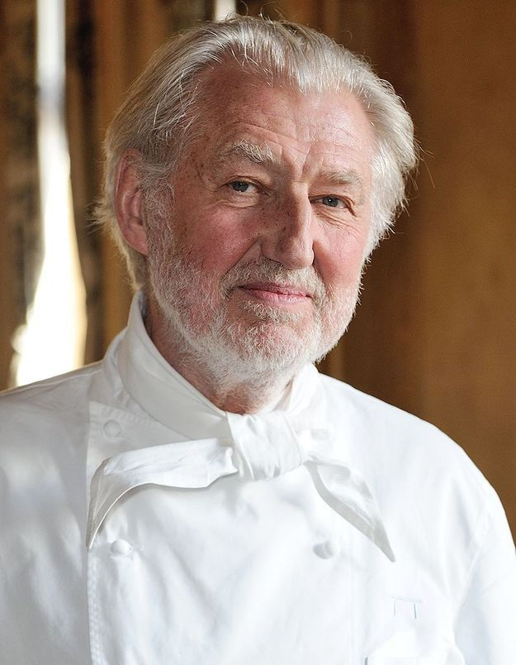



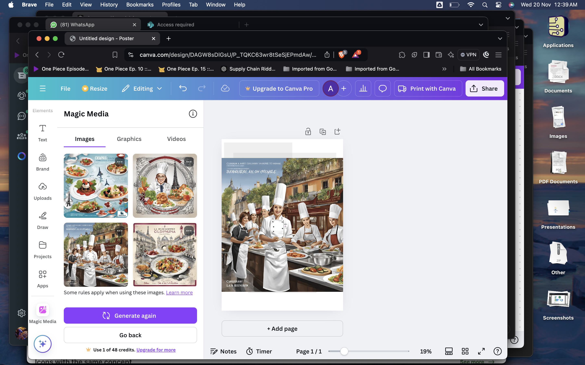












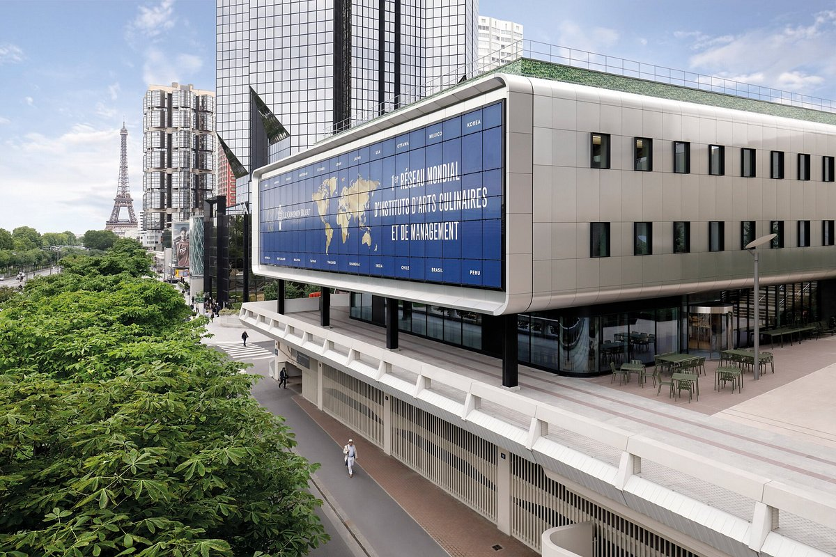






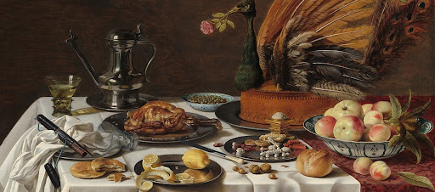
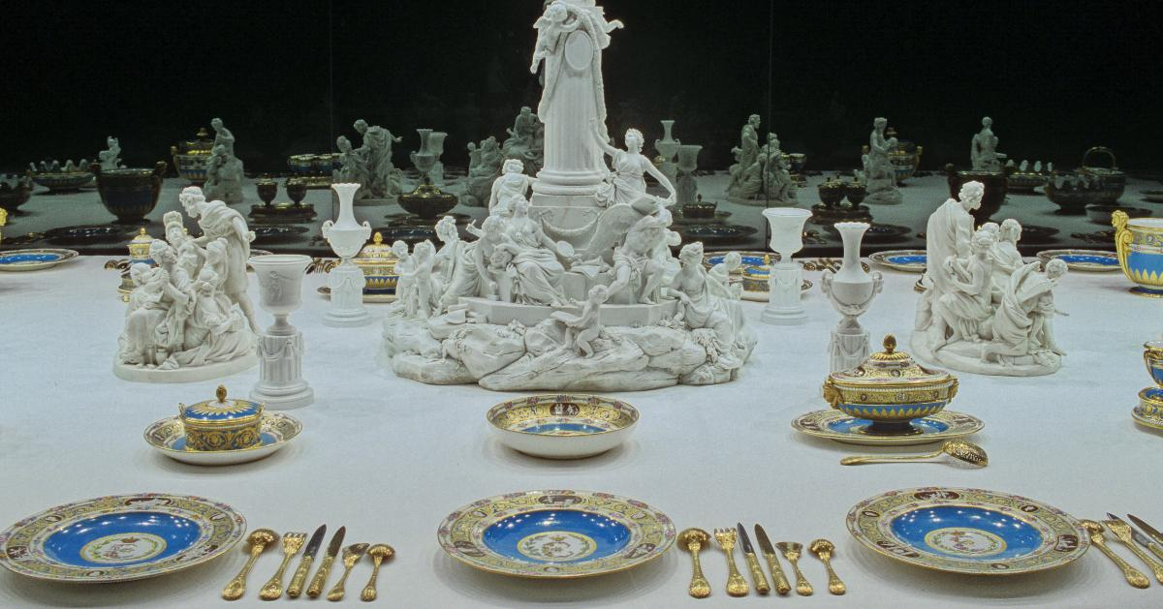





MARKETING STRATEGIES
How L’Élégance du Passé can Market itself to Distinguish itself from Competitors
UNVEILING OUR BRAND ICON
CULINARY EXCELLENCE SCHOLARSHIP PROGRAM
EVENT STRUCTURE
14 Michelin Star Rated
Gastronomic Excellence
Winner awarded a unique title and marketing spotlight
Full scholarship for culinary training or mentorship
Positioning the restaurant as a tribute to fine dining's artistry, Pierre Gagnaire stands as the perfect ambassador for this mission.
A partnership could help preserve his legacy by associating his name with emerging excellence.
Why
Participants present signature dishes.
Gains
Open to culinary arts students in Paris.
Parisian Connection
Trust and Credibility
Pierre Gagnaire
Recruitment Opportunity
Legacy Building
ULTIMATE GOAL
RECRUIT STUDENTS OF CULINARY ARTS FOR INTERNSHIP AS WELL AS PLACEMENT
To Become 3 Michelin Star Rated Restaurant
Recruit students of culinary arts In Institute like
‘Le Cardon Bleu’
for internship as well as placement
OUTCOMES
FOR MARKETING
Staff Of World’s top Culinary Arts Institute
Aid In Achieving Main Goal
Promotion will Be Done Amongst Future Industry Star
Cost Effective
Building Loyalty
Only 10 in whole France
Higher Demands
A Luxury In Itself
Free Publicity
Enhanced Social Media Presence
Global Spotlight
PROMOTING OURSELF BY
Highlighting historical inspiration behind dishes.
Featuring stories of French royalty and their dining traditions
Showing team dedication and personalized service in action.
A well known restaurant for Hospitality
Opens doors for expanding into other locations
Attracts premium suppliers eager to associate with a top-tier restaurant.
Attracts partnerships with luxury brands.
Elevates the restaurant's prestige
Boosts visibility through features in culinary magazines
Market Research
Market Entry Strategy
Customer Value Proposition
Marketing & Promotion
Appendix
Size & Timeline
4

Slide 6






GO TO MARKET – SIZE AND TIMELINE
Estimating the Market Size & Time required for Establishment and Growth
Target Addressable market
TIMELINE
PHASE 1
PHASE 2
PHASE 3
ELABORATIVE
$ 7.35 billion
Expansion within the Country
Serviceable Addressable market
Achieving 3 Michelin Star Rating
Reaching towards Break even & Profitability
$1.65 billion
Starting the Scholarship & Intern Programmes
Serviceable Obtainable market
Grand opening featuring Pierre Gagnaire as a Brand Ambassador
$ 87.5 million
Secure Funding and Soft Opening of the Restaurant
12 24 36 48 60 72 84 96 108
Estimating an obtainable Market Size in this Competitive Market
No of Months
Must Win Battles To Acquire Market Leadership
Market Competition
Cost of Starting
Unforgettable Brand
Identity
Profitability
Regulatory Complications
To succeed, we must outsmart .
Implementing Robust Internal Policies, regular Audits, fostering a Compliance-driven Culture.
competitors with innovative.
$550000- 600000
Building an unforgettable Brand.
We will gain Profitability
in 4-5 years after opening.
strategies, exceptional service..
identity requires creativity & connection
Market Research
Market Entry Strategy
Customer Value Proposition
Marketing & Promotion
Appendix
Size & Timeline
5

Slide 7
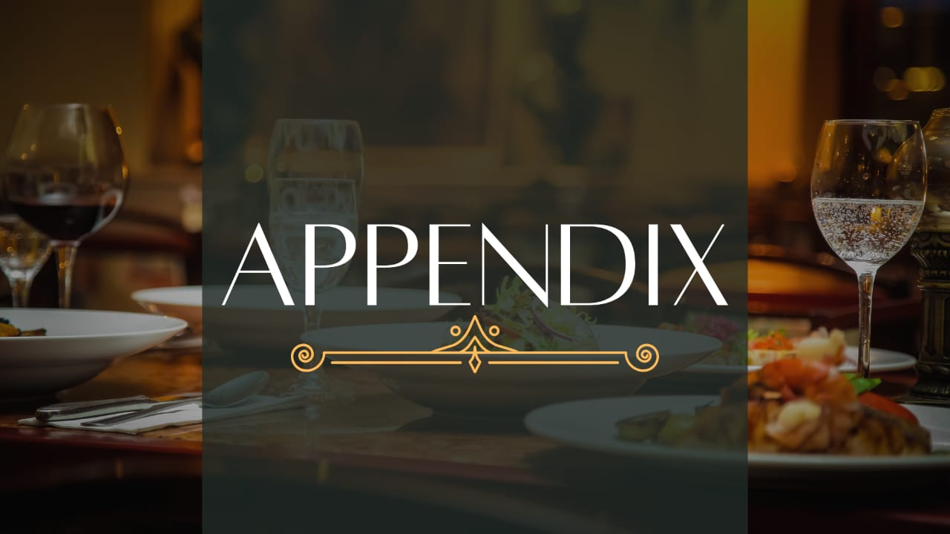
eXPLO
Analyzing the target market and positioning of brand
Executive Summary
Market Research
Target Market
Launching Strategies
Localization
Marketing Strategy
3

Slide 8

APPENDIX
Justifying the Pricing of the restaurant
Justifying Luxury Pricing
Premium Ingredients: High-quality, organic, and rare seasonal ingredients sourced locally or globally
Unique Dining Experience: Immersive storytelling with a “rat chef” theme, making dining an event
Artisanal Dishes: Expert chefs crafting innovative dishes with French tradition and creativity
Prime Location: Situated in a prestigious Parisian area, Montmartre adding exclusivity and convenience.
Limited Seating: Intimate, personalized service for a high-end clientele
Sustainability: Eco-friendly sourcing and ethical practices with higher operational costs
Luxury Branding: Positioned as a premium experience akin to fine art or fashion.
Market Research
Market Entry Strategy
Customer Value Proposition
Marketing & Promotion
Appendix
Size & Timeline
1

Slide 9
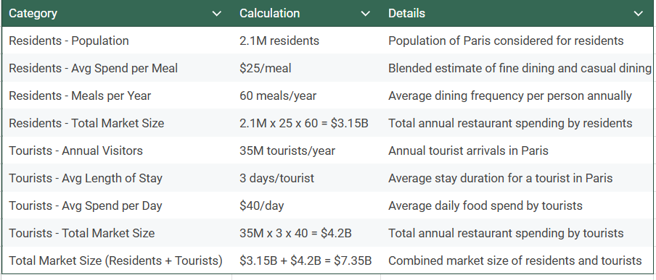
APPENDIX
Calculating the TAM, SAM & SOM
CALCULATING TARGET ADDRESSABLE MARKET
CATEGORY
CALCULATION
ELABORATIVE
Market Research
Market Entry Strategy
Customer Value Proposition
Marketing & Promotion
Appendix
Size & Timeline
2

Slide 10
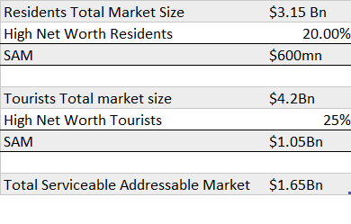
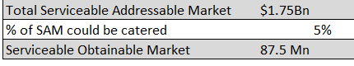
APPENDIX
Calculating the TAM, SAM & SOM
CALCULATING SERVICEABLE ADDRESSABLE MARKET
ELABORATIVE
CATEGORY
CALCULATION
(Around)
$700 Mn
CALCULATING SERVICEABLE OBTAINABLE MARKET
CATEGORY
CALCULATION
$1.75Bn
Market Research
Market Entry Strategy
Customer Value Proposition
Marketing & Promotion
Appendix
Size & Timeline
3

Slide 11
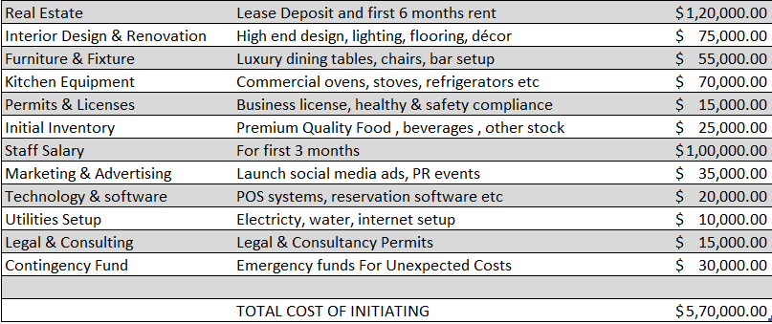
APPENDIX
Calculating the Cost of Restaurant
ELABORATIVE
CALCULATION
CATEGORY
DETAILS
COST
CATEGORY
Market Research
Market Entry Strategy
Customer Value Proposition
Marketing & Promotion
Appendix
Size & Timeline
4

Slide 12
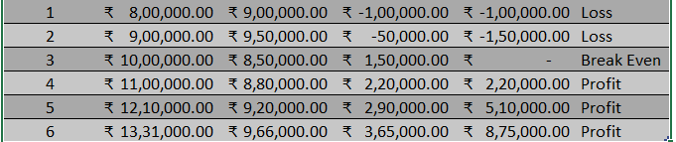
APPENDIX
Calculating the time to reach Profitability
CALCULATION
Years
Revenue
Operating Expenses
Net Profit/Loss
Cumulative
Profit /loss
Status
$
$
$
$
$
$
$
$
CATEGORY
$
$
$
$
$
$
$
$
$
$
$
$
$
$
$
$
Assuming Revenue Growth By 10-11%
Market Research
Market Entry Strategy
Customer Value Proposition
Marketing & Promotion
Appendix
Size & Timeline
5

Slide 13
APPENDIX
Sources For The Secondary Data
Sources --
[USDA Report on Food Service - Hotel Restaurant Institutional in Paris, France](https://agriexchange.apeda.gov.in/MarketReport/Reports/Food%20Service%20-%20Hotel%20Restaurant%20Institutional_Paris_France_FR2022-0017.pdf)
Citations:
[1] Chain Restaurants in the US - Market Research Report (2014-2029) https://www.ibisworld.com/united-states/market-research-reports/chain-restaurants-industry/
[2] France Foodservice Market Size and Trends by Profit and Cost Sector Channels, Players and Forecast to 2028 https://www.globaldata.com/store/report/france-foodservice-market-analysis/
[3] Full-Service Restaurants in Paris - Market Research Report (2014-2029) https://www.ibisworld.com/paris/market-research-reports/full-service-restaurants-industry/
[4] Food Service & Hospitality market research reports by IBISWorld https://www.marketresearch.com/IBISWorld-v2487/Food-Service-Hospitality-c169/1.html
[5] THIS REPORT CONTAINS ASSESSMENTS OF COMMODITY AND TRADE ISSUES MADE BY USDA STAFF AND NOT NECESSARILY https://agriexchange.apeda.gov.in/MarketReport/Reports/Food%20Service%20-%20Hotel%20Restaurant%20Institutional_Paris_France_FR2022-0017.pdf
[6] Single Location Full-Service Restaurants in the US - IBISWorld https://www.ibisworld.com/united-states/market-research-reports/single-location-full-service-restaurants-industry/
Status
Market Research
Market Entry Strategy
Customer Value Proposition
Marketing & Promotion
Appendix
Size & Timeline
6

Slide 14


